Slide 1
Maniac Magee
Jerry Spinelli

Slide 2
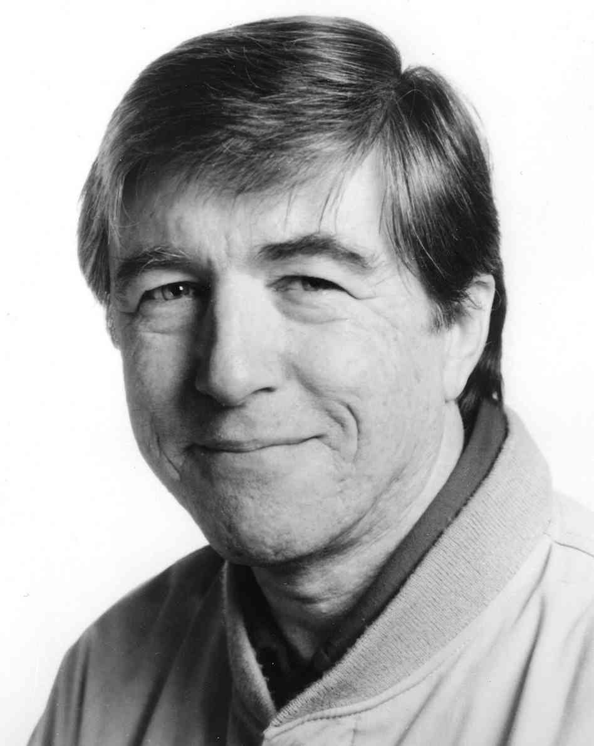
Jerry Spinelli
Jerry Spinelli (born February 1, 1941) is an American author of children's novels on adolescence and early adulthood. He is best known for the novels Maniac Magee and Wringer.
Spinelli was born in Norristown, Pennsylvania and currently resides in Phoenixville, PA. At the age of sixteen, his love of sports inspired him to compose a poem about a recent football victory. Later, unbeknownst to him, his father published it in the local newspaper. It was at this time he realized that he would not become a major league football player, and decided to become a writer instead.

Slide 3
A Tale of a Hero
Maniac Magee is one part tall tale, two parts lessons about life. It has many themes that will teach us important lessons to remember years after we’ve closed the book.

Slide 4
Themes
Friendship
Racism
Home
Family
Being a Hero

Slide 5
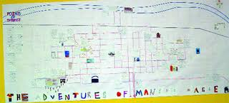
Town of Two Mills
Maniac lives in a town divided by race and prejudice.

Slide 6
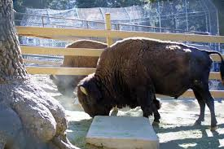
Hero’s Tale
Maniac is a true “tall tale” hero as we will see. He starts from nothing – poor, homeless – and becomes a legend that everyone can look up to.
At some point, he even lives with wild buffalo!

Slide 7
Other books by Jerry Spinelli
Night of the Whale
Dump Days
Maniac Magee
The Bathwater Gang
Hallie Jefferys Life
Fourth Grade Rats
Report to the Principal’s Office
There's a Girl in My Hammerlock
Do the Funky Pickle
Who Ran My Underwear Up the Flagpole?
Picklemania
Tooter Pepperday
Crash (Spinelli novel)
The Library Card
Wringer
Blue Ribbon Blues: A Tooter Tale
Knots in My Yo-Yo String
Stargirl
Loser
Love, Stargirl
Milkweed: A Novel
My Daddy and Me
Eggs
Smiles to Go
I Can Be Anything!
"Jake and Lilly"
"Hokey Pokey"

